Slide 1
Safety and environment for external collaborators

Slide 2

Safety and environment
for external collaborators

Slide 3

Safety and environment
In this presentation you will learn the following:
  Traffic plan information, risks,
  What to do in case of an accident or a fire,
  The location of emergency points,
  And the main safety regulations applicable on the site
Every employee is responsible for his own health and safety, as well as the health and safety of others.
“Setting a good example is not a way of exerting influence.
It is the only one.” - Albert Schweitzer

Slide 4
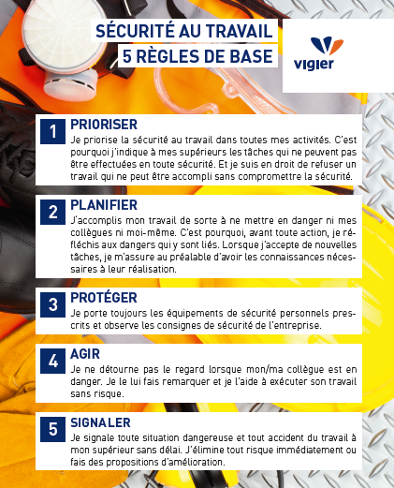

Safety and environment
The health and safety of employees is an absolute priority for Vigier: You must return home as healthy as you came to work.
SAFETY IN THE WORKPLACE
5 BASIC RULES
1
PRIORITIZE
I make safety at work a priority in all my activities. That's why I tell my superiors about any tasks that cannot be carried out safely. And I have the right to refuse work that cannot be done without compromising safety.
Extract from Vigier's commitment to safety and health
2
PLAN
I carry out my work in such a way as not to endanger either myself or my colleagues. That's why, before taking any action, I think about the dangers involved. When I take on new tasks, I make sure beforehand that I have the necessary knowledge to carry them out.
3
PROTECT
I always wear the prescribed personal safety equipment and observe the company's safety instructions.
I HAVE THE RIGHT TO SAY
STOP
IN CASE OF DANGER
4
ACT
I don't look away when my colleague is in danger. I point it out and help them to do their job safely.
5
REPORT
I report any dangerous situation or accident in the workplace to my superior without delay. I eliminate any risk immediately or make proposals for improvement.

Slide 5












Traffic plan of the site
Parking
révisions
3
1
2
5
Reception
Logistics / Shipping
Wood hall
Oils – contaminated water
FLUFF (secondary fuel)
4
Trucks
Light vehicles only
Access for unloading Fluff in reverse
Stone quarry

Slide 6
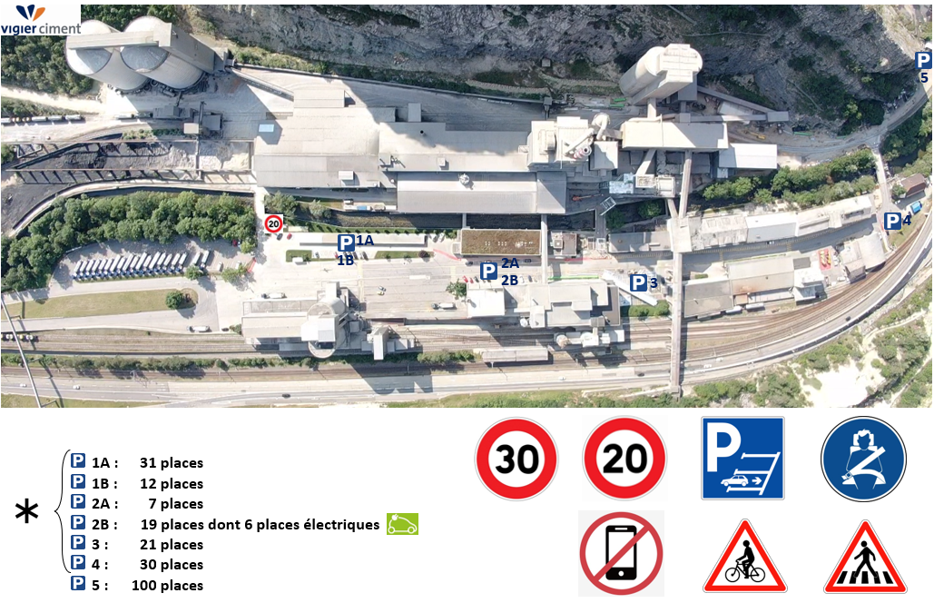

Traffic and Parking
Follow the traffic plan and the signs.
Always maintain visual contact with drivers of construction machinery and trains.
31 places
12 places
7 places
19 places incl. 6 electric places
21 places
30 places
100 places used by external collaborators
during revisions periods
During revisions, no parking for external companies

Slide 7

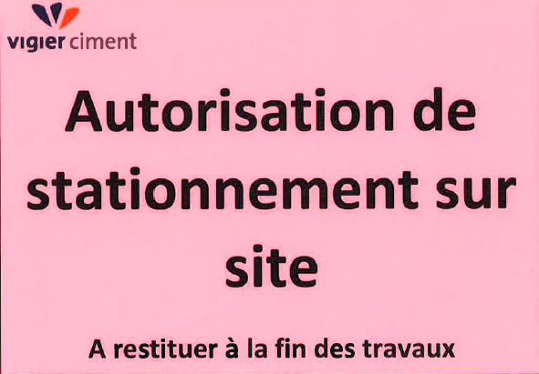
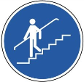



Pedestrian traffic
No parking in front of building entrances, fire hydrants and electrical rooms.  During revisions, external companies must park in the car park 5
No vehicles may be parked outside the car parks.
Except with a permit:
Be careful when walking:
Caution with vehicles, machines and trains:
  Watch out for moving vehicles. You have no right of way with trains and construction machinery, so make yourself noticed by those in motion and wait for their permission before passing.
  Make yourself known to the drivers and wait for their approval before passing through.

Slide 8

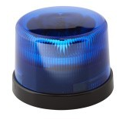


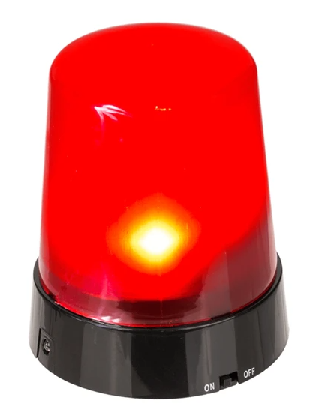
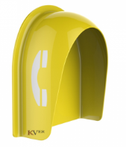
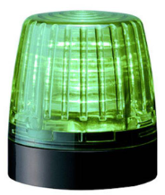
Warning signals
Danger: Injection of azote, risk of asphyxiation
Danger: Moving train
Calls to landlines in noisy areas (heat exchanger/oven and mills)

Slide 9
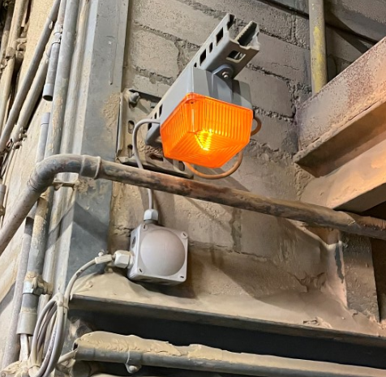
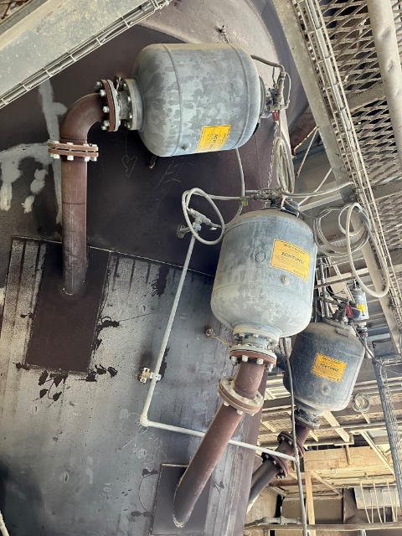
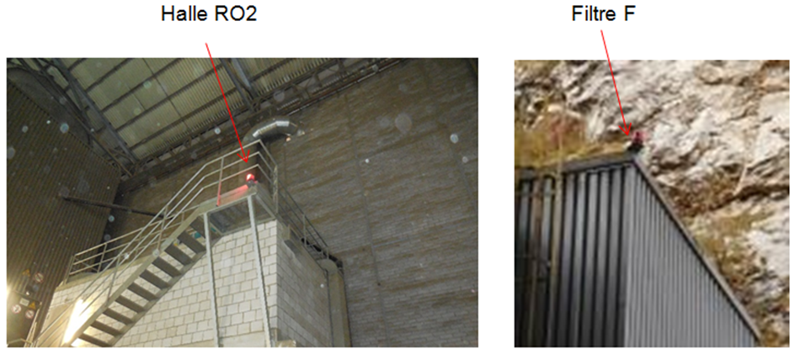
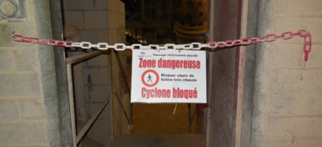
Warning signals
Danger: Air cannons in action
Danger: Cyclone clogging

Slide 10
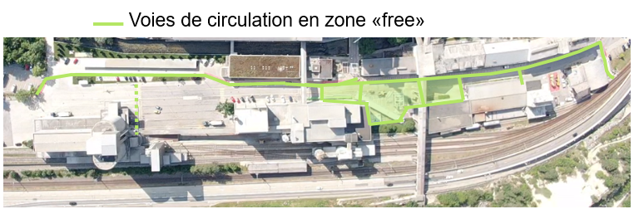
The wearing of PPE on site
Traffic lanes in the free zone

Slide 11







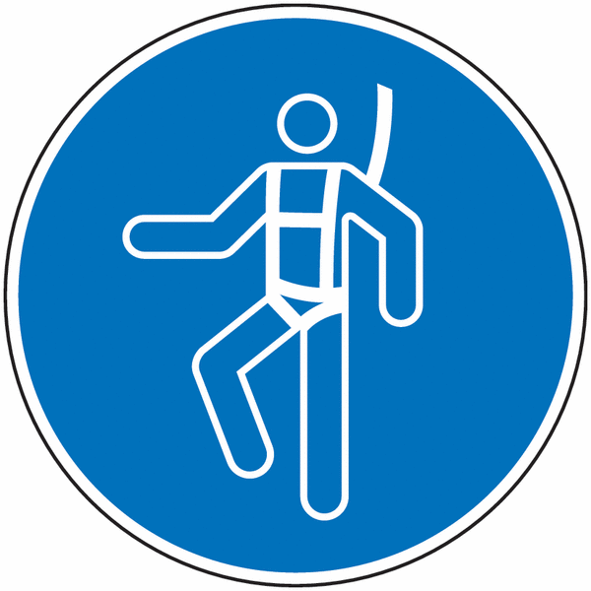




Personal protective equipment (PPE)
PPE is mandatory on the entire site under all circumstances (exception in emergency points and in the office)
  Helmet
  Safety goggles
  Safety shoes
  Highly visible / reflective work clothing
  The wearing of shorts is prohibited
Other PPE may be compulsory depending on the risks involved:
For other premises, follow the obligation signs posted
at the entrance to the premises

Slide 12
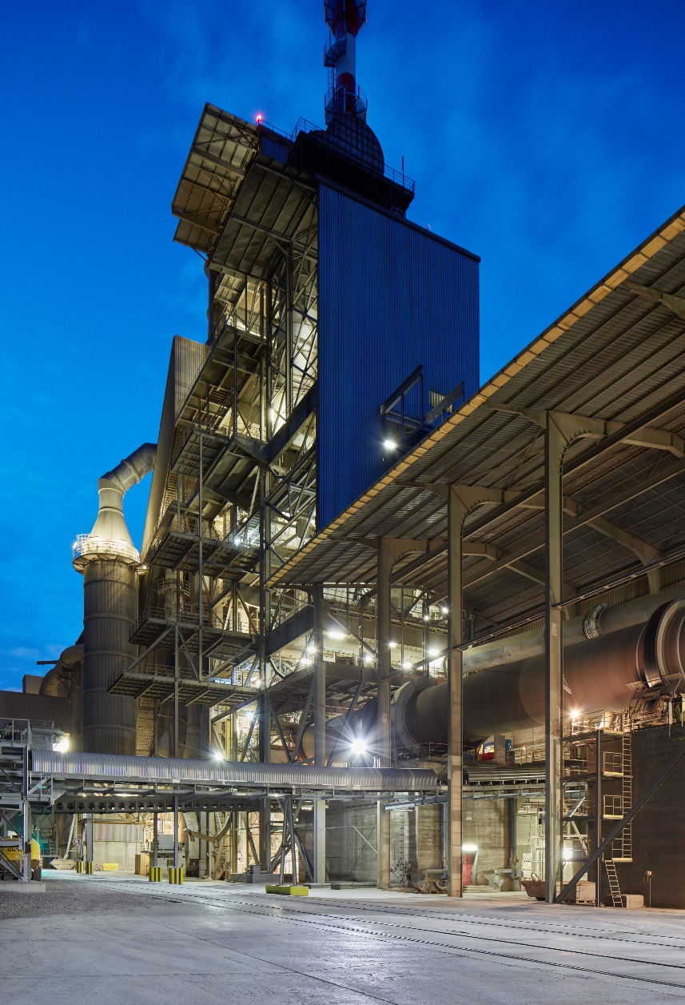

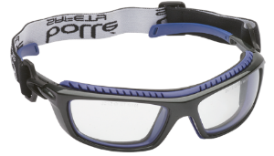
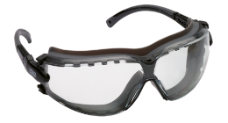
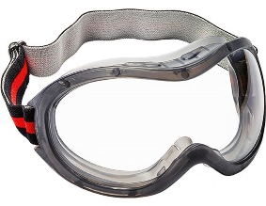
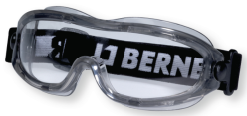
PPE – Access to the heat exchanger
Waterproof or semi-waterproof goggles must be worn

Slide 13
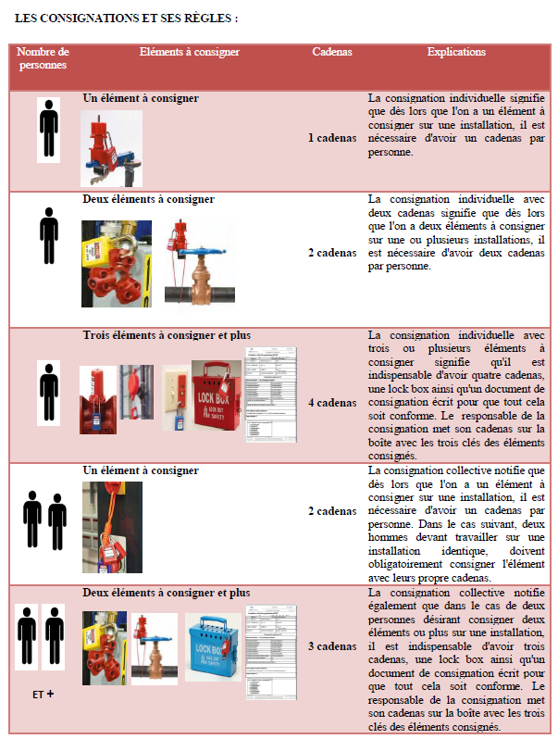
Before starting your work
All work must be the subject of a work order. This will be issued by your case manager.
A work permit will be issued in case of special risks:
  Welding, cutting, grinding work → Fire permit
  Working in an ATEX zone → ATEX permit
  Working in restricted zones → Permit for restricted zones
  Working at heights (outside gondolas and scaffolding)
  and unsecured roof access → Heights permit
  Excavation work → excavation work permit
When maintenance work is to be done with energy:
Each participant must attach his/her padlock to the main switch or the lockbox.

Slide 14
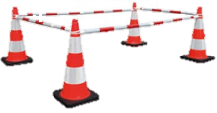

Marking
Secure your work area for yourself and others.
Lifting work, falling objects, falling from a height, ...
Never cross barriers without being authorized to do so.
ensure that marking is respected
At the end of the work, when all the collective protection has been put back in place and/or the risk has disappeared, the site manager must remove the temporary signs she/he had put in place.

Slide 15
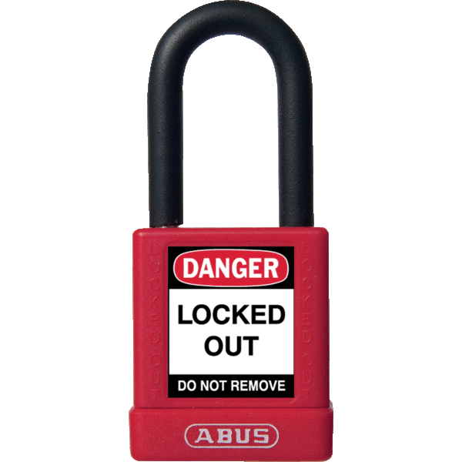
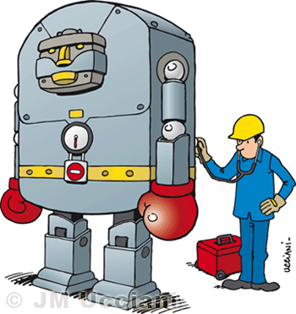

Consignment
All maintenance work should be directed to the Vigier contact.
Types of consignment:
  Electrical
  Mechanical
  Pneumatic
  Thermal
  Hydraulic
  Others
Check with the Vigier contact that the equipment on which you are working is consigned.
No work may begin before the approval of the Vigier contact.
  Please note that a stationary installation does not mean that it has been shut down, let alone locked down.
  Each worker must place his padlock on the main switch or in the hole box.

Slide 16
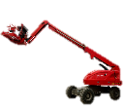
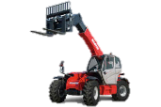
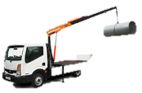
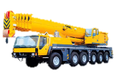
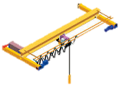
Use of cranes / crane bridges
How to use a crane bridge or crane on the Ciments Vigier construction site:
  You must have the necessary training (mandatory Swiss forklift truck examination)
  You must be in possession of a driving licence:
    From your employer
    From Vigier Ciments
  You need to be medically fit.
The machinery of the external companies must be:
  In good operating condition (check before use)
  Periodically checked.
List of the devices concerned:
  Construction machinery
  Forklift
  Overhead crane
  Crane (mobile and tower)
  Auxiliary loading crane
  Gondola (Wearing a safety harness is mandatory for some gondolas)

Slide 17

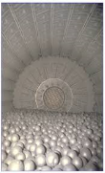
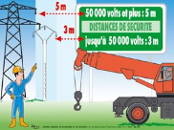
Electrical risk
It is forbidden to enter rooms with electricity or to work in an electrical box without the authorization and electronics permission (from the employer and Vigier Ciment).
Portable tools/equipment must be in good condition.
Small conductive enclosures (closed room with conductive walls):
  Examples: Crusher, hopper, cyclone, cooler, furnace, ...
  The voltage used must be 24V or an isolation transformer must be used.
Contact the Vigier Case Manager via your Site Manager to resolve any electrical problems.
Be careful when working near ground and
overhead power lines.

Slide 18
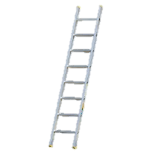



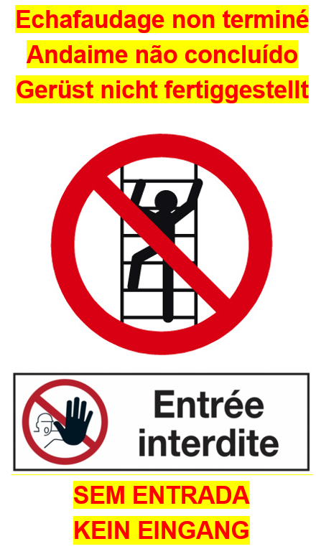
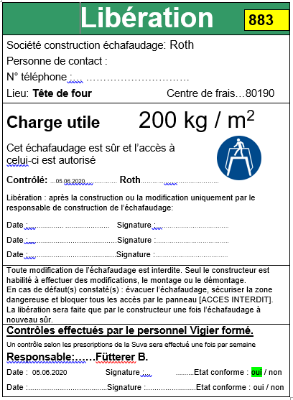
Risk of falling from a height
Ladder: The ladder is an aid, not a working platform.
PPE (safety harness, rope, … )
  The employee must be trained.
  The equipment must be in good condition (check before and after use).
Scaffolding:
  Are assembled by trained personnel.
  Must be accepted by a trained person (applicant).
  Each company ensures that the scaffolding meets its needs.
  Each company ensures that the receipt is available and carries out a daily check.
  No access until the scaffolding is received!
Unfinished scaffolding
Entry prohibited

Slide 19
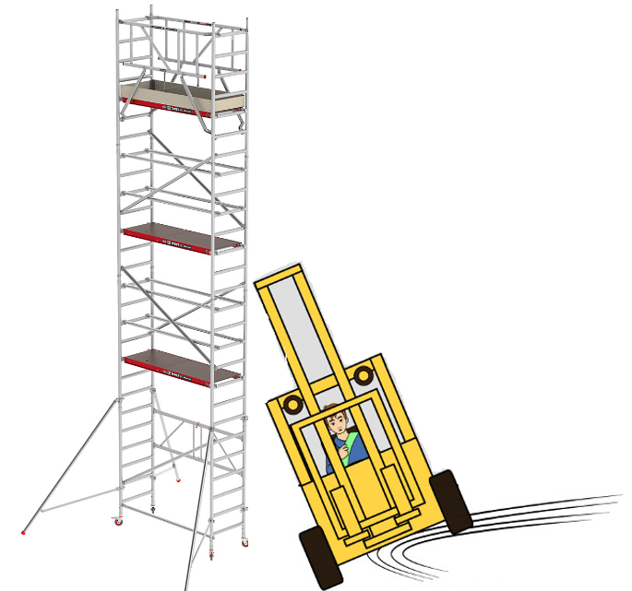
Daily scaffold condition check
Since it was delivered, the scaffolding may have suffered some damage linked to:
Wind
Temperature variations
Dismantling of a component by another company (e.G. Dismantling of an engine)
Impact with machinery
Deterioration of ground support (rain, etc.)
Overloading of the boards with equipment
…
Every day, the team leader of each company using the scaffolding must carry out the daily check. He will certify this check by writing the date, his name, the name of his company and his signature on the back of the release sheet.

Slide 20
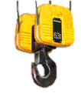
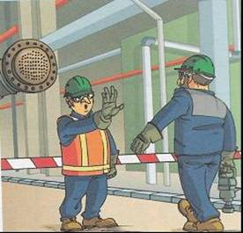
Lifting operations
Be vigilant.
Mark the lifting area.
Make sure that your lifting zone is respected.
A single, identifiable person is responsible for lifting.
Never walk under the load
Depending on the type of lifting work, the preparation of a protocol or a permit is mandatory. This is made with Vigier Ciment, the external company and the lifter before the work begins.

Slide 21
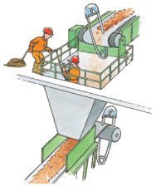
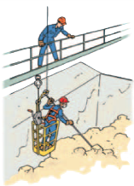
Confined spaces
Confined space permit issued by Vigier Ciment
During work you must:
    Have the operation continuously monitored by a designated person equipped with an alarm system until the work is completed. This person is not allowed to enter the confined room.
    Check the atmosphere to avoid the risk of suffocation and / or explosion.

Slide 22
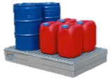
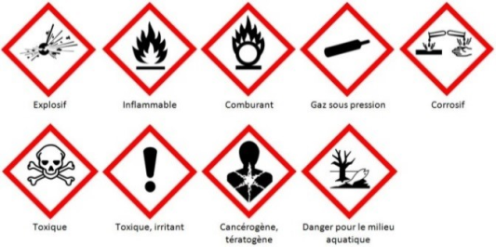


Chemical risks
Depending on the type of work and the area of application, you may come across these products:
  The wearing of adapted PPE is mandatory.
You may be exposed to dust.
FFP3 type respiratory protection must be worn.
Safety data sheets (FDS) are available for inspection. Ask you Vigier contact.
Explosive
Flammable
Coburant
Gas under pressure
Corrosive
Toxic
Toxic, irritant
Carcinogenic, teratogenic
Danger for the aquatic environment

Slide 23


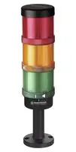
Radioactive radiation
There are risks when passing radioactive radiation.
The affected areas are marked with this pictogram:
If I have to work in an affected area, I check with the Vigier Case Manager if the preventive measures have been implemented (recording of sources, ...).
For the online analyser, I can only access the monitored sector if the indicator light is green.

Slide 24
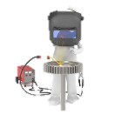

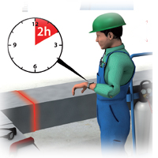
Hot work operations
Definition: All work that generates sparks and / or hot surfaces.
Examples: Grinding, welding, flame cutting, ...
Fire permit is MANDATORY
  Ask the Vigier Case Manager.
  The permit will be prepared with the external company, the Vigier Case Manager and a person authorised to sign.
  A fire permit is only valid for ONE establishment, in ONE zone and for ONE external establishment.
Validity: 1 day

Slide 25





ATEX risks
ATEX: ATmosphère Explosive – Potentially explosive atmospheres
The ATEX zones are marked with these pictograms:
In these zones applies:
For all work in these zones, the measures to be taken must be described in the work permit (cleaning, ventilation, suitable equipment, etc.).

Slide 26

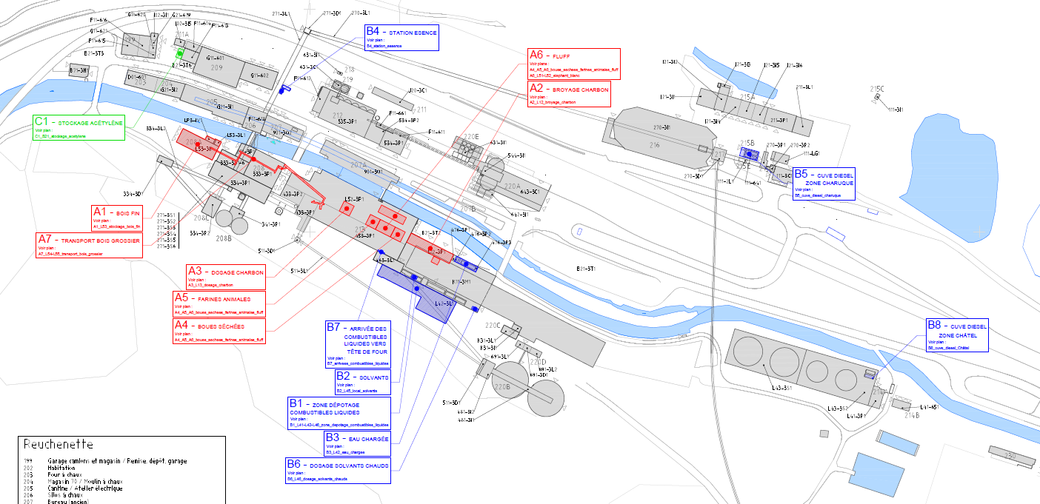
ATEX Zones

Slide 27
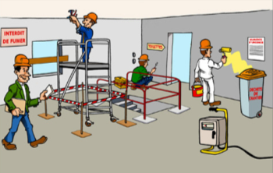
Co-Activities
Notice and take note of work around you.
Lifts / freight elevators
  Observe the maximum load of the equipment.
  Do not block equipment.
  Lifts / freight elevators always need to be at ground level.
Be careful with your equipment (theft, damage...).

Slide 28

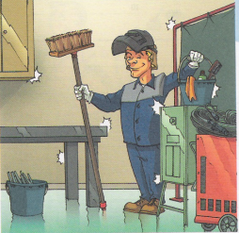
Tidiness and cleanliness
Do not block passageways.
Clean up your work area after each working day, reintroduce collective protective measures or barrier the area.
Work is only finished when the site is tidy, clean and all collective protective equipment (protective housing, railings...) have been restored to its original state.

Slide 29

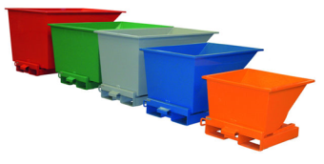
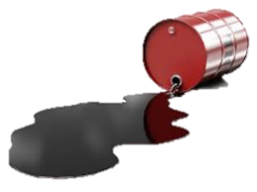
Waste / Environment / Energy
Waste bins are at your disposal.
  Follow the sorting.
In case of accidental spillage:
  Apply the instruction in case of emergency

Slide 30
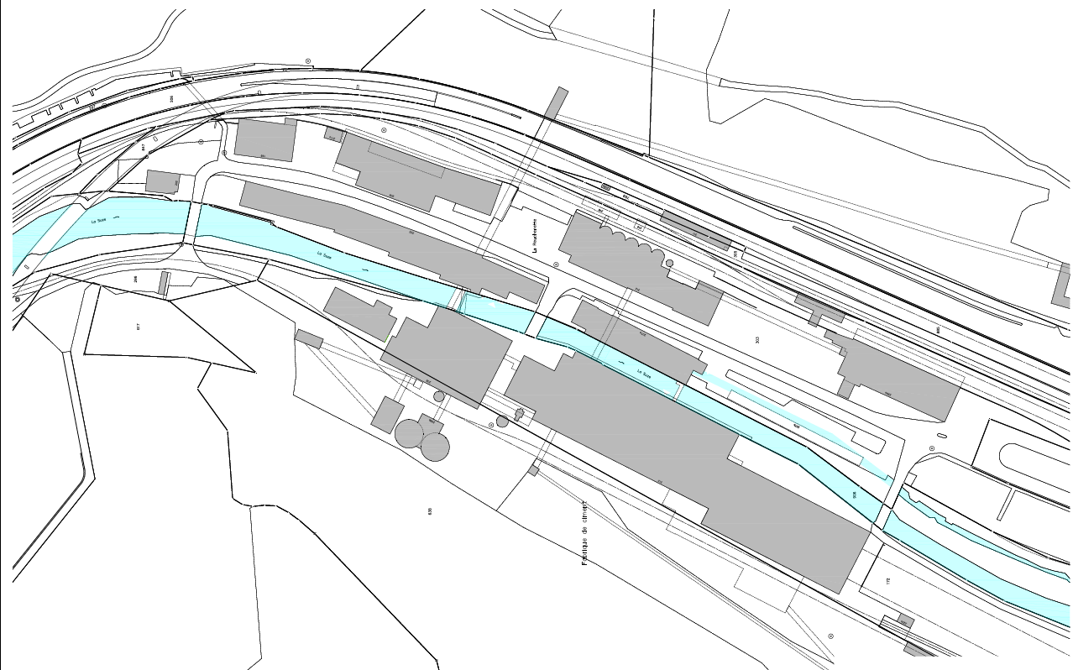

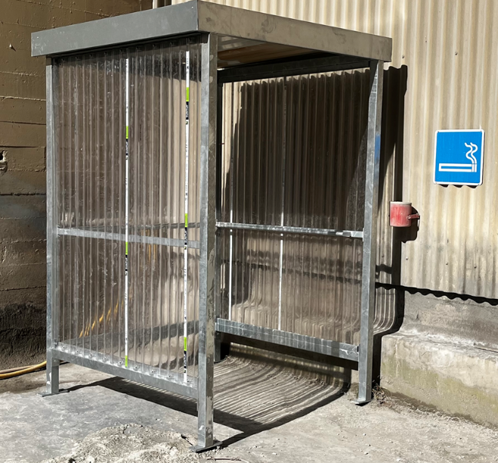
Smoking areas
Smoking is strictly prohibited outside these areas

Slide 31


Smoking areas
Charuque
Tscharner Quarry
Smoking is strictly prohibited outside these areas

Slide 32

What to do in case of an accident?
The emergency number is on the sticker you will be given when you arrive on site. You can also save it.

Slide 33




Evacuation plan
Main meeting point
215C
Only if smoke is preventing access to the main assembly point
Zone Ex
Escape route
Zone with combustible susbtance
Underground escape route
Explosives
Access to the site
Meeting point
Maximum permissible weight on the bridge

Slide 34






Hygiene and Health - Main measures and recommendations
Wear a mask in case of symptoms
Keep changing rooms and toilets clean and tidy

Slide 35


Good behaviour in meeting rooms
EXCELLENT
GOOD / SATISFACTORY
MEDIUM
Polluted ambient air
Ventilation recommended
BAD
Highly polluted ambient air
Ventilation required
Example on 10.12.2021 in the Old Offices room during forklift operator training (6 people present in the room)

Slide 36

Thanks for your attention

