Slide 1
Safety and environment for drivers

Slide 2

Safety and environment for drivers

Slide 3

Safety and environment for drivers
In this presentation you will learn the following:
  Information on the traffic plan and risks,
  What to do in the event of an accident or fire,
  Location of living areas,
  The main safety rules applicable on the site,
  How the weighing and recording system works.e
Every employee is responsible for his own health and safety, as well as the health and safety of others.
“Setting a good example is not a way of exerting influence.
It is the only one.” - Albert Schweitzer

Slide 4
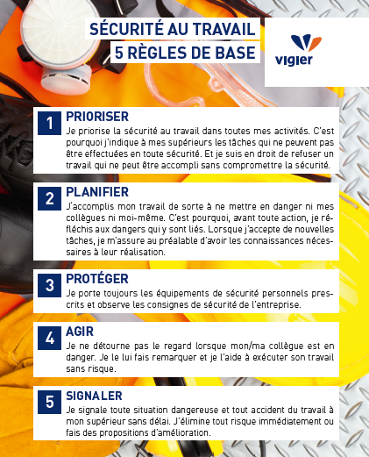

Safety and environment for drivers
The health and safety of employees is an absolute priority for Vigier: You must return home as healthy as you came to work.
SAFETY IN THE WORKPLACE
5 BASIC RULES
1
PRIORITIZE
I make safety at work a priority in all my activities. That's why I tell my superiors about any tasks that cannot be carried out safely. And I have the right to refuse work that cannot be done without compromising safety.
Extract from Vigier's commitment to safety and health
2
PLAN
I carry out my work in such a way as not to endanger either myself or my colleagues. That's why, before taking any action, I think about the dangers involved. When I take on new tasks, I make sure beforehand that I have the necessary knowledge to carry them out.
3
PROTECT
I always wear the prescribed personal safety equipment and observe the company's safety instructions.
I HAVE THE RIGHT TO SAY
STOP
IN CASE OF DANGER
4
ACT
I don't look away when my colleague is in danger. I point it out and help them to do their job safely.
5
REPORT
I report any dangerous situation or accident in the workplace to my superior without delay. I eliminate any risk immediately or make proposals for improvement.

Slide 5












Traffic plan of the site
Parking
révisions
3
1
2
5
Reception
Logistics / Shipping
Wood hall
Oils – contaminated water
FLUFF (secondary fuel)
4
Trucks
Light vehicles only
Access for unloading Fluff in reverse
Stone quarry

Slide 6





Circulation
No parking in front of building entrances, fire hydrants and electrical rooms.
Be careful when walking
Caution with vehicles, machines and trains
  Watch out for moving vehicles - you do not have priority over trains and site machinery
  Make yourself known to the drivers and wait for their approval before passing through
Always maintain visual contact with drivers of construction machinery and trains

Slide 7












Personal protective equipment (PPE)
ARE MANDATORY IN PRODUCTION FACILITIES
  Helmet
  Safety goggles
  Safety shoes
  Highly visible / reflective work clothing
  The wearing of shorts is prohibited
Other PPE may be compulsory depending on the risks involved:
For other premises, follow the obligation signs posted at the
entrance to the premises

Slide 8
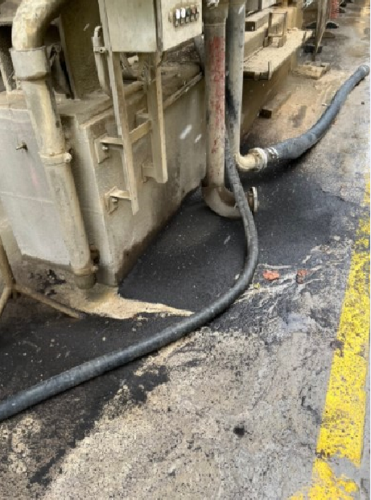

Tidiness and cleanliness
Do not block passageways
Clean up your work area after each working day, reintroduce collective protective measures or barrier the area
Work is only finished when the site is tidy, clean and all collective protective equipment (protective housing, railings...) have been restored to its original state
In case of a leak, call the emergency number :
+41 (0)32 485 03 33

Slide 9

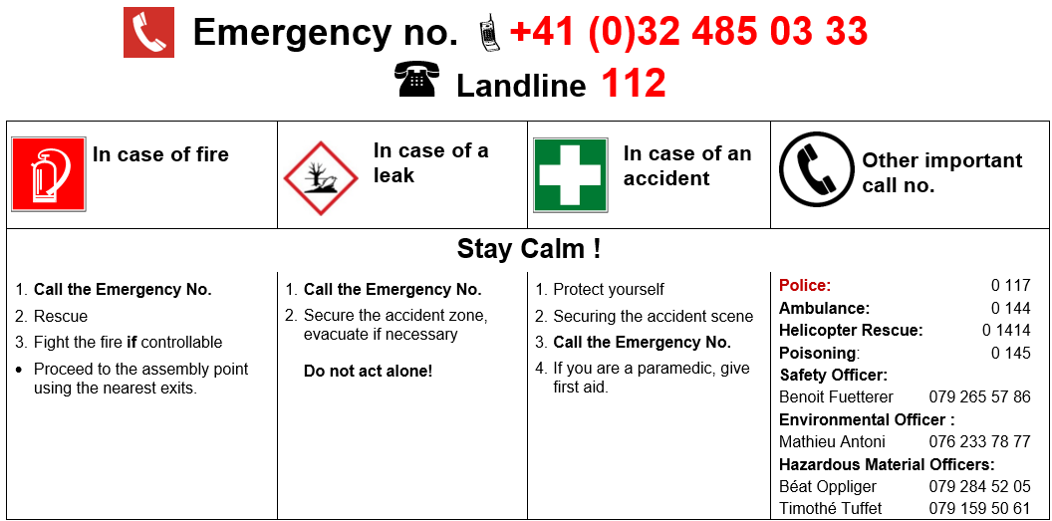
What to do in case of emergency

Slide 10




Evacuation plan
Main meeting point
215C
Only if smoke is preventing access to the main assembly point
Zone Ex
Escape route
Zone with combustible susbtance
Underground escape route
Explosives
Access to the site
Meeting point
Maximum permissible weight on the bridge

Slide 11
Deliveries of materials

Slide 12
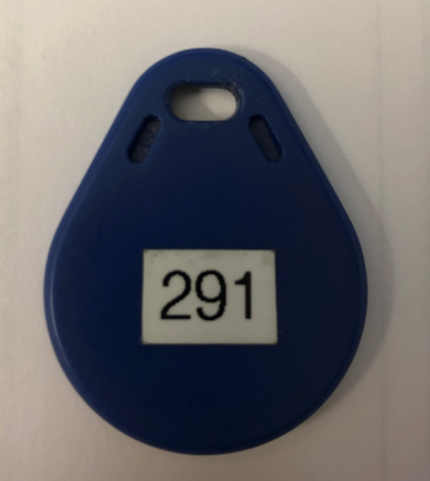
Generalities
Is this your first visit to the Ciments Vigier site in Péry to deliver materials? Please follow the instructions below.
At the entrance to the site, you'll find a weighing machine and 2 kiosks in operation 24/7, all of which are needed to register your delivery.The information you enter on the screen is very important from a legal point of view. That's why we're counting on you to make sure it's done in a rigorous way.
Before leaving the loading site, make sure you have a badge or badge number. This badge is pre-configured by us and contains information to identify its origin.
If this is not the case, please contact Mr Béat Oppliger (beat.oppliger@vigier.ch ; +41 (0)79 284 52 05). A badge will be configured and sent to you when you arrive on site.
Badge

Slide 13
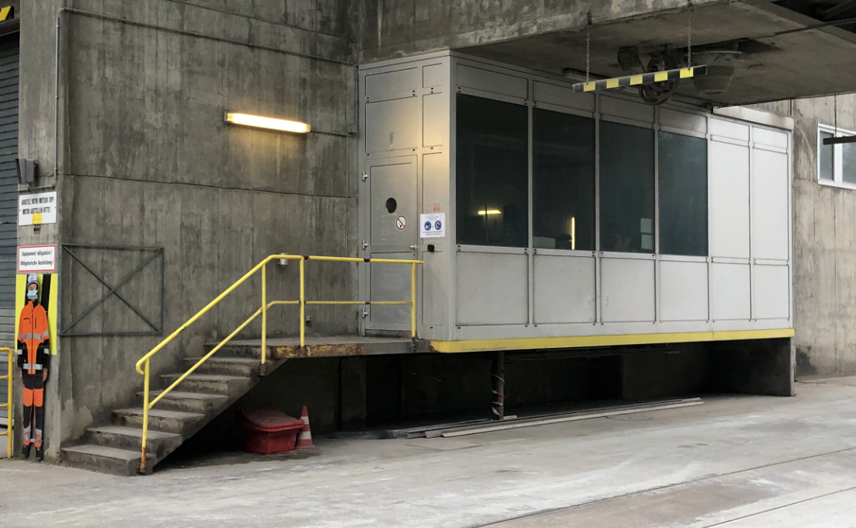
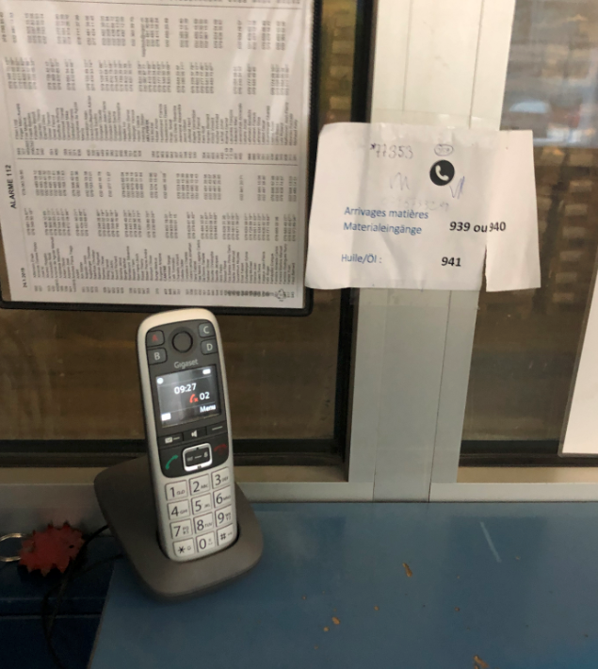
Generalities
If you have any questions or encounter any difficulties throughout the procedure, go to the weighing room and use the telephone provided.
Dial 939. A Ciments Vigier employee will answer and guide you or come and help you.
You can also call +41 (0)79 159 50 61 from a mobile phone.
If you have any problems outside normal opening hours (6am-6pm), call the control centre on 400.

Slide 14
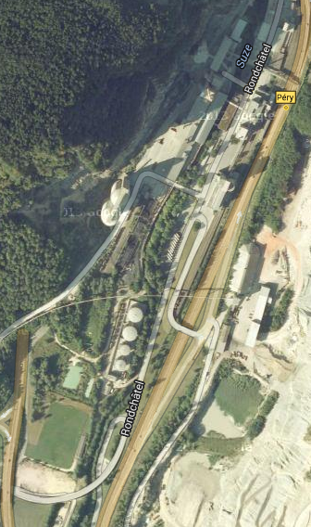
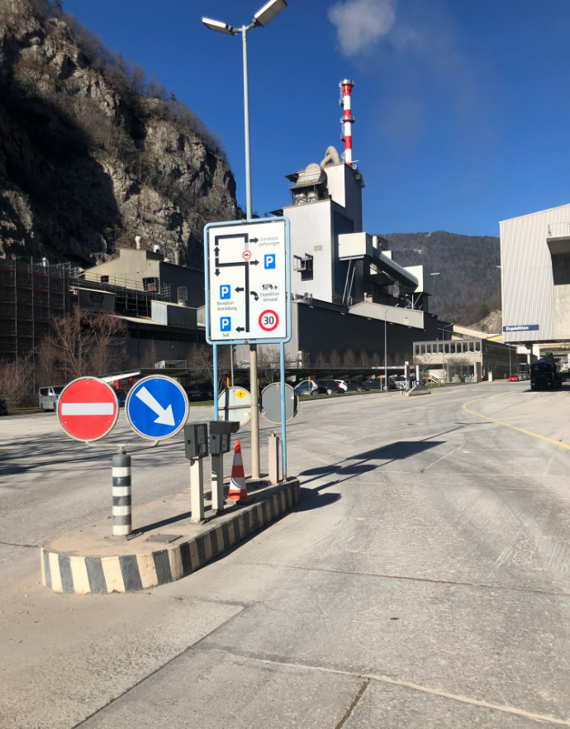
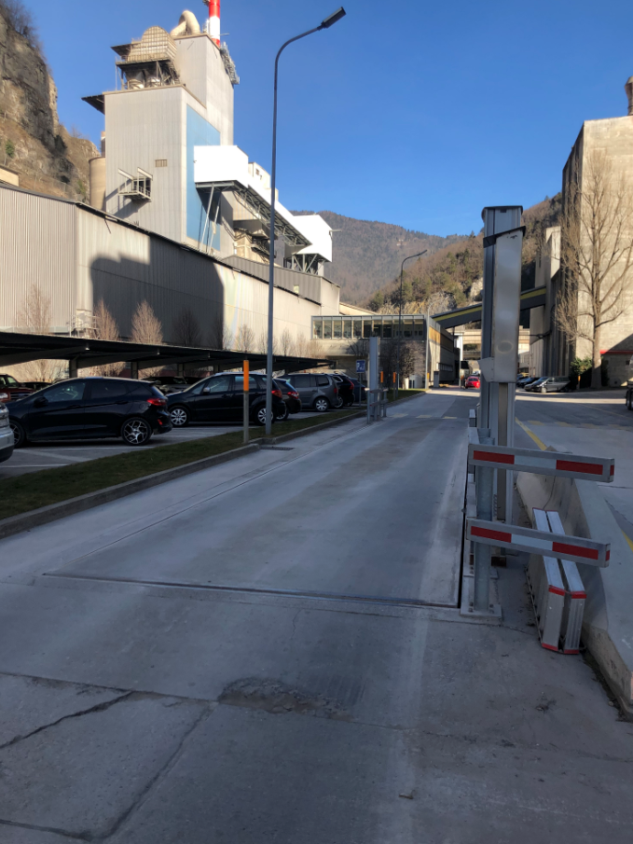
Delivery procedure
Supplier balance

Slide 15
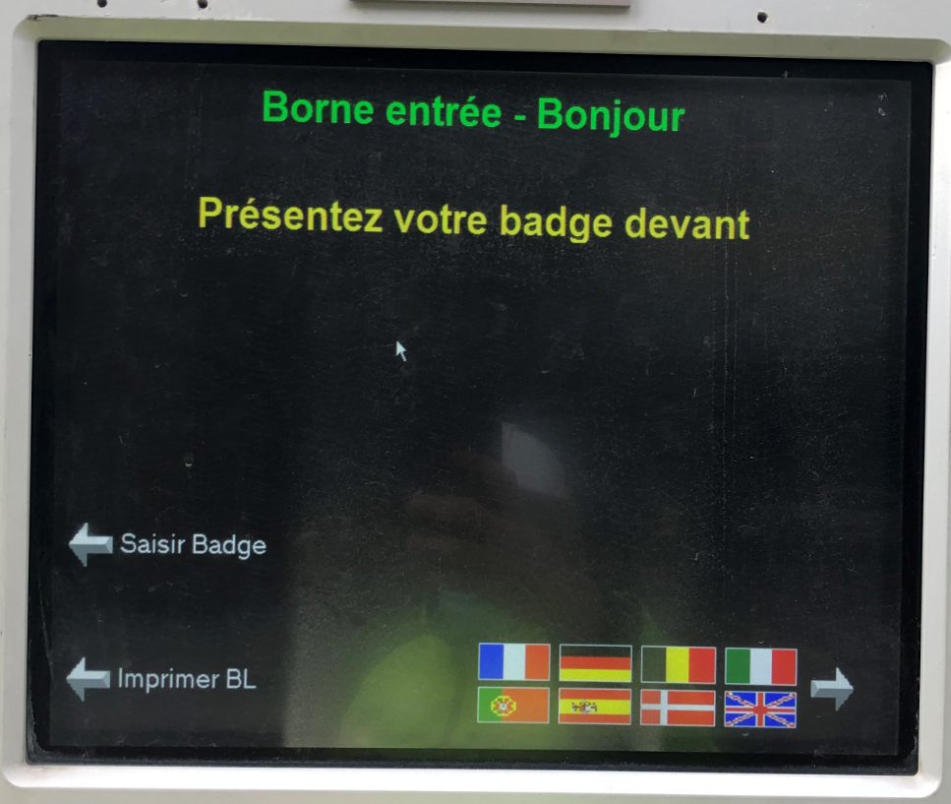
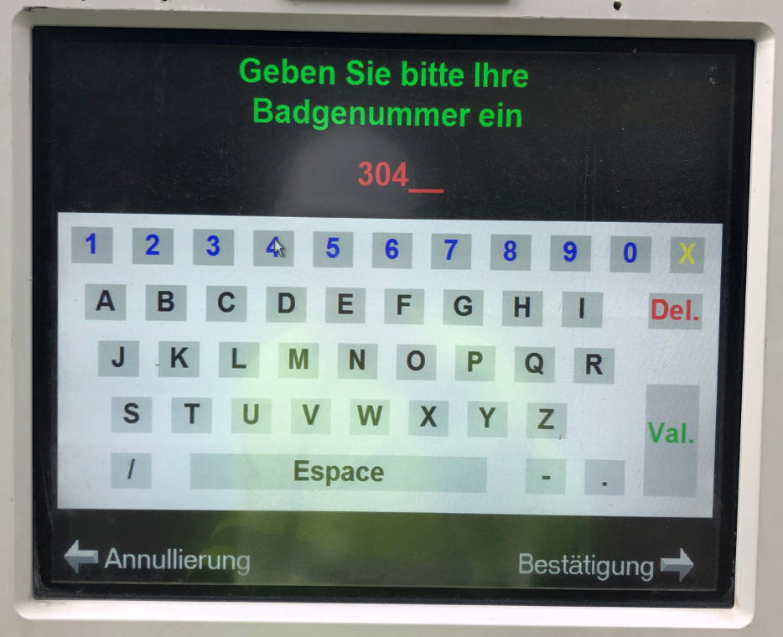

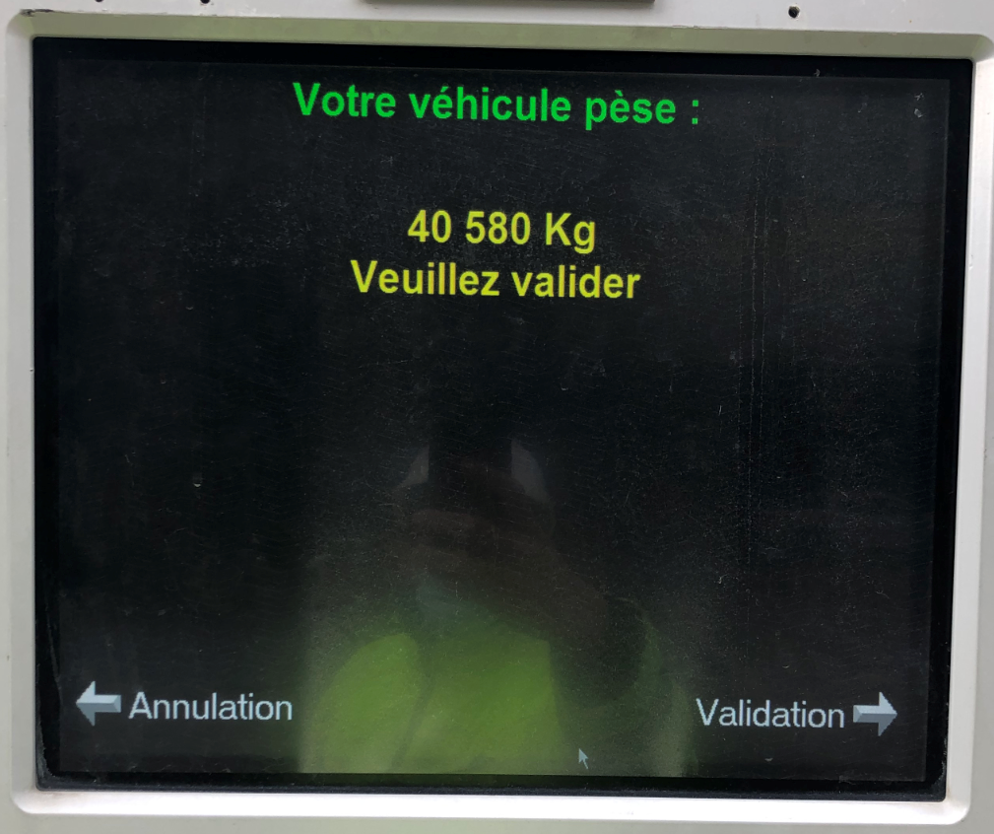
Entry procedure
Choose your preferred language and press ‘Enter badge’.
1
Enter your badge number on the touch screen and press ‘Validate’ or ‘Validate’.
You can correct your entry at any time using the yellow cross.
Important! The same 2 badge numbers must never be used at the same time. If you only have one badge for several people, wait until your colleague has exited the site before using the number. Otherwise you will be blocked and a lot of time will be lost by everyone.
2
Validate the weight of your vehicle
3

Slide 16
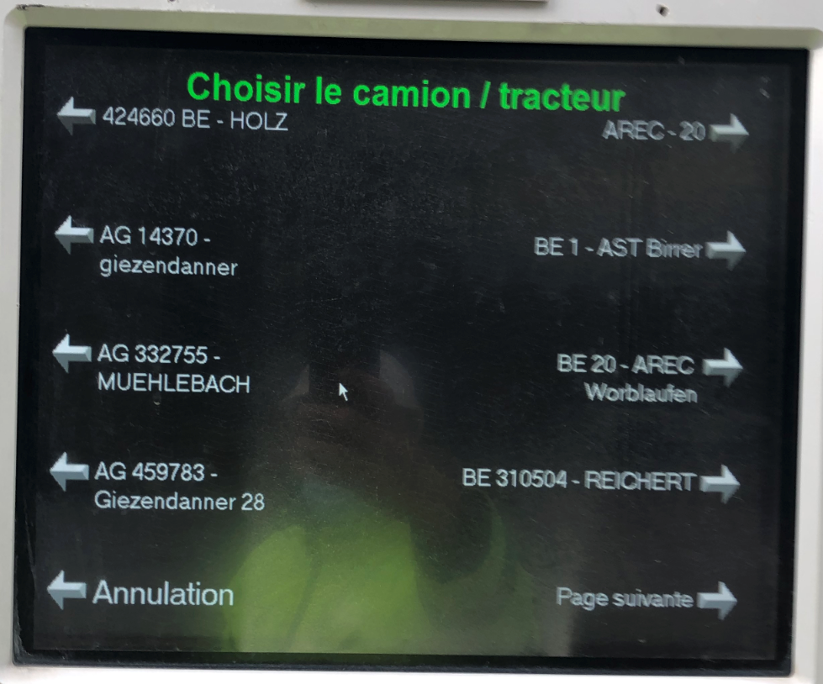
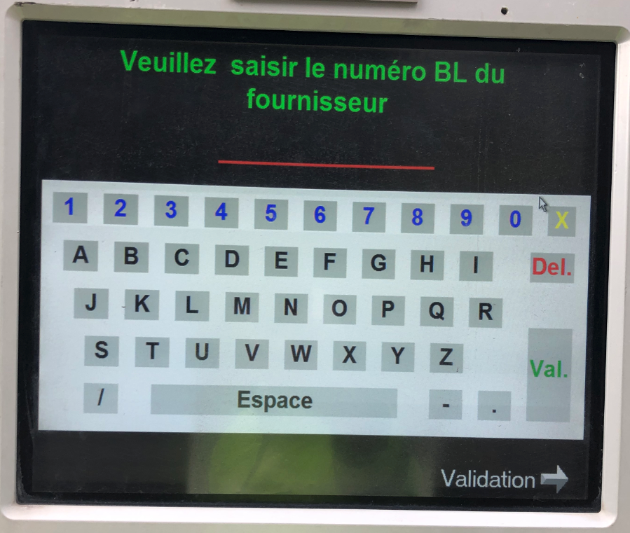
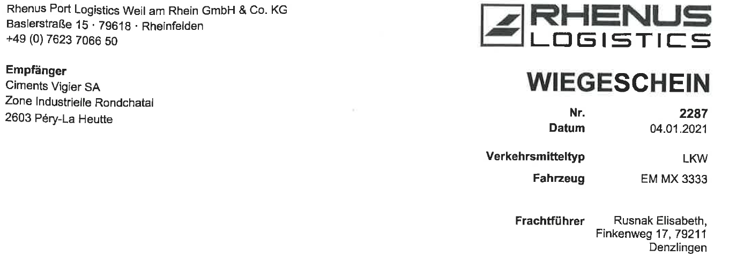
Entry procedure
You now need to select the vehicle that will be making the delivery.If your vehicle is already registered, look for it in the menu and click on it.
If your vehicle has never been on the site before, go to the ‘next page’ arrow on the last page of the Menu. ‘arrow on the last page of the Menu. Click on ‘Other’ to enter your vehicle's registration number (tractor).
4
At this stage, enter the delivery note number.
Then press ‘Validate’ or ‘Validation’.
5
Once you have completed the last step, you will return to the home screen.This means that you have successfully completed your entry.
You can unload your goods in accordance with the instructions given by Beat Oppliger (beat.oppliger@vigier.ch; +41 (0)79 284 52 05).
6

Slide 17
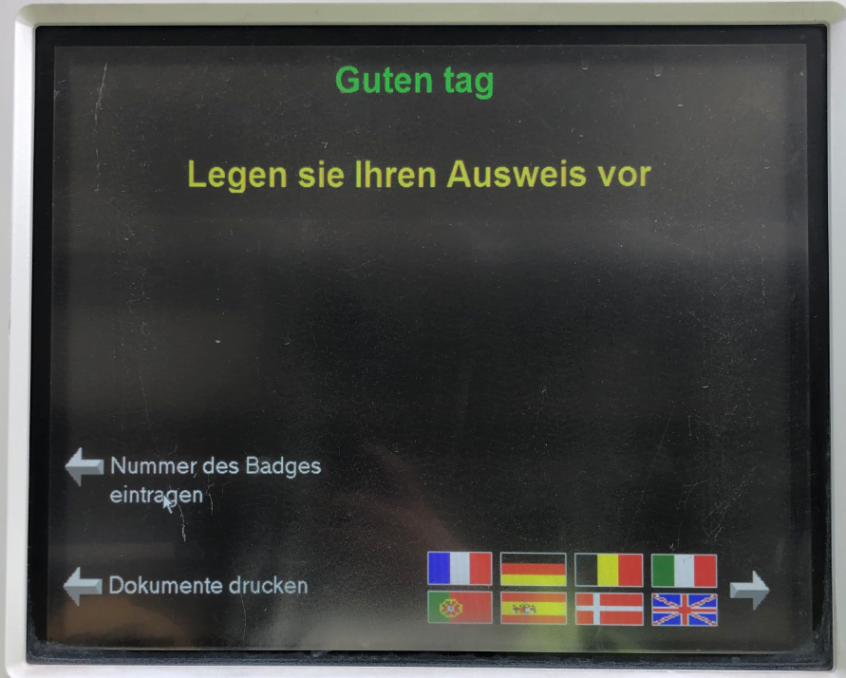
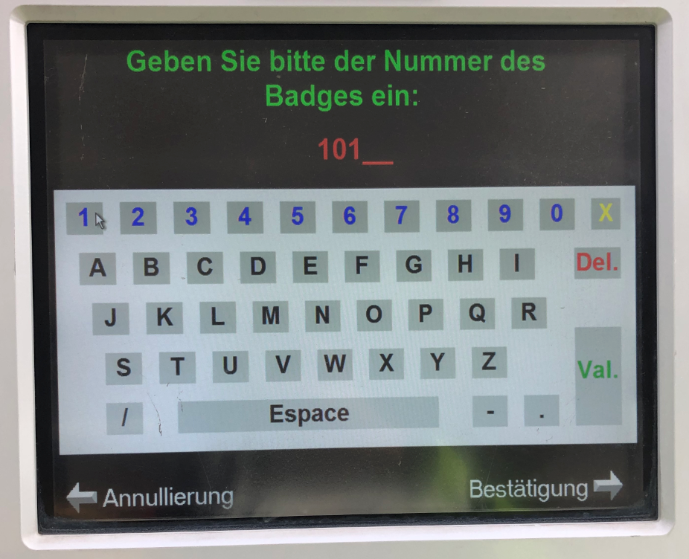
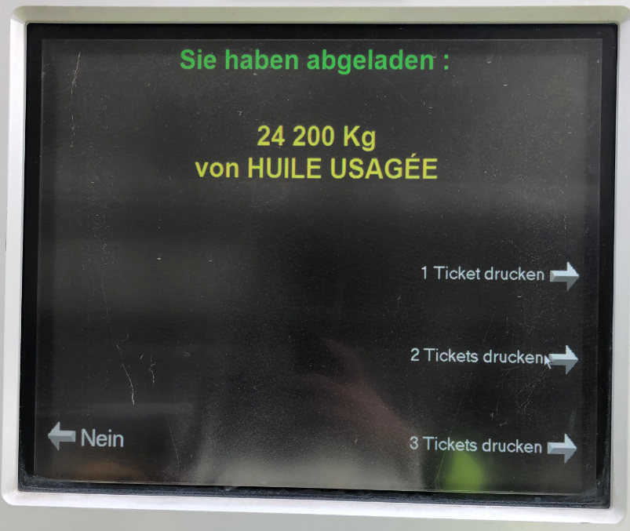
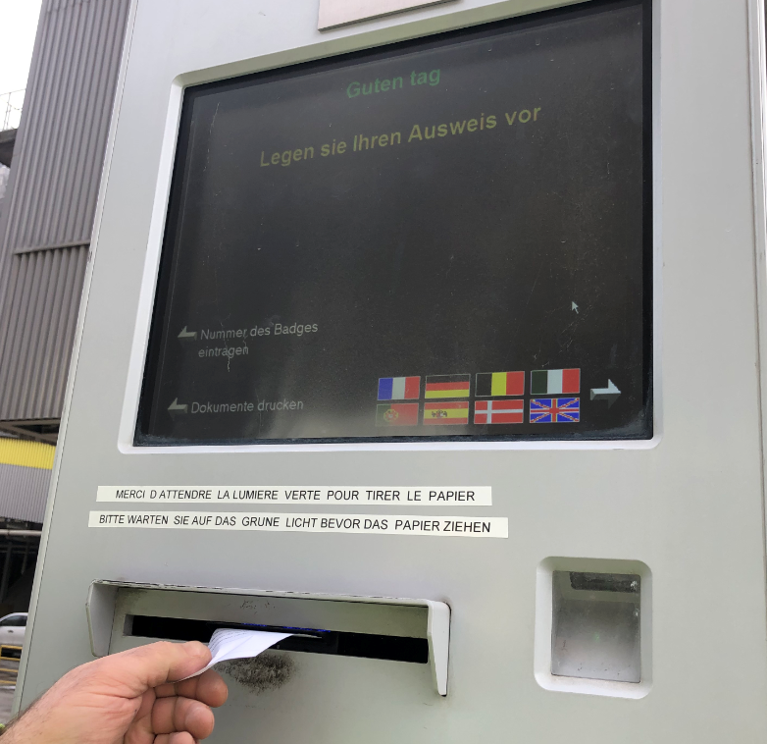
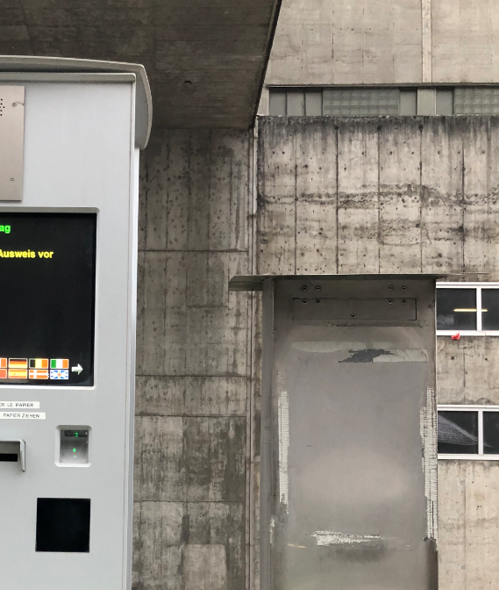
Exit procedure
Choose your language and/or enter your badge number
Confirm
1
Choose the number of receipts you want
Wait for the ticket(s) to be issued
A ticket will be issued as soon as the previous one has been collected
2
Sign at least one of the tickets
Hang it with the delivery documents and place it in the letterbox next to the terminal.
You can now leave the site having followed the procedure correctly.
We wish you a pleasant journey!
3

Slide 18

Thanks for your attention

